Slide 1
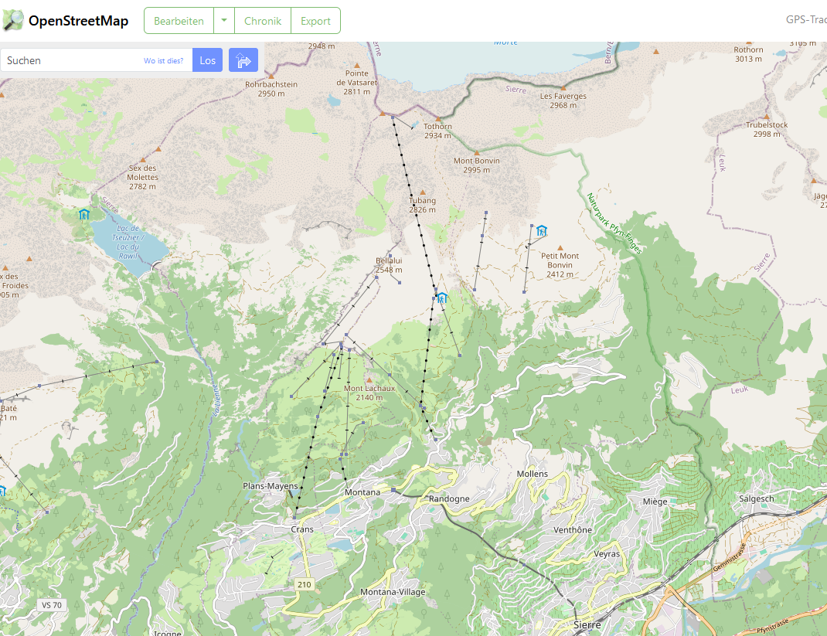
https://www.openstreetmap.org/#map=15/46.3075/7.4621

Slide 2
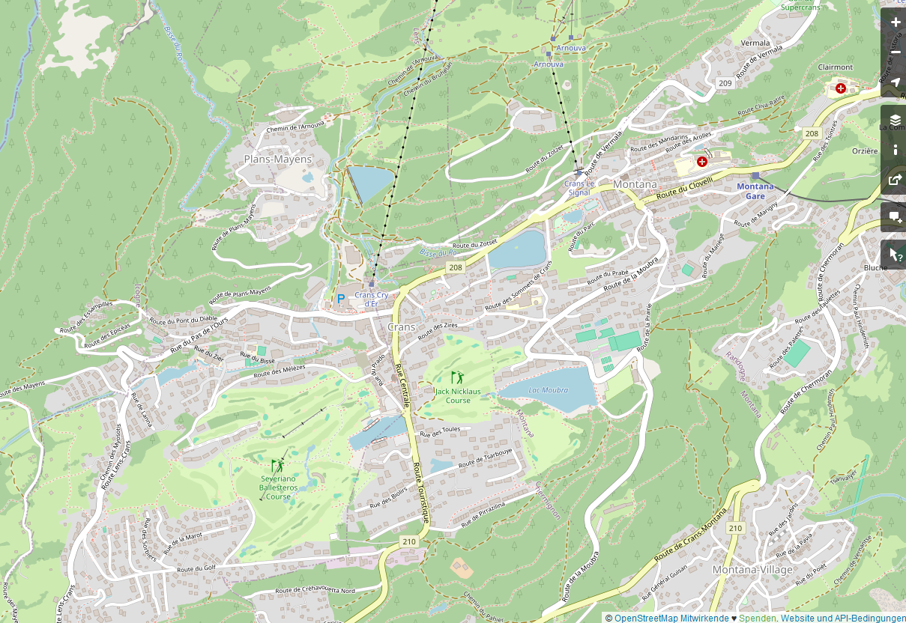
https://www.openstreetmap.org/#map=15/46.3075/7.4621

Slide 3
Crans Montana

